Slide 1
Logging
Using Log4J Framework

Slide 2
Introduction
Key terms and Terminology

Slide 3
Introduction
Uses of Log4J
Creating logs
Creating traces
Logging does have its drawbacks
It can slow down an application
If too verbose, it can cause scrolling blindness. To alleviate these concerns, log4j is designed to be fast and flexible

Slide 4
Manual Logging (Console-based)
Mostly used by novice: System.out.println(…)
We need a logging framework to replace all these System.out.println(…) statements and to send the output to a different target, instead of the console like to a file or any other destination

Slide 5
Why people forget to log?
Pollute source code…☹
Decrease the legibility of the sources…☹
Increase the size of the sources…☹
Running-time performance is at stake…☹
For validation only … ☹

Slide 6
Log4J: A Framework
Log4J Framework
Already compiled
Can disable or enable logging at runtime
Statements embedded inside the sources
Log4j is a popular logging package written in Java.log4j has been ported to the C, C++, C#, Perl, Python, Ruby, and Eiffel languages.

Slide 7
Installation
JLog4 can be downloaded at http://logging.apache.org/log4j/2.x/download.html
New version is 2.x
Add log4j JAR file to you Eclipse project or configure a CLASSPATH directory through your environment settings

Slide 8
Core Components
Log4j API has been designed in layered where each layer provides different object which performs different tasks.
This makes design flexible and very much extendable in future based on need.
There are two type of objects available with Log4j framework.
Core Objects: These are mandatory objects of the framework and required to use the framework.
Support Objects: These are optional objects of the framework and support core objects to perform addition but important tasks.

Slide 9
Core Objects
LOGGER OBJECT:
The top level layer is Logger which provides Logger object. The Logger object is responsible for capturing logging information and they are stored in a namespace hierarchy.
LAYOUT OBJECT:
The layer provides objects which are used to format logging information in different styles. Layout layer provides support to appender objects to before publishing logging information.
Layout objects play an important role in publishing logging information in a way that is human-readable and reusable.
APPENDER OBJECT:
This is lower level layer which provides Appender object. The Appender object is responsible for publishing logging information to various preferred destinations such as a database, file, console, UNIX Syslog etc.

Slide 10
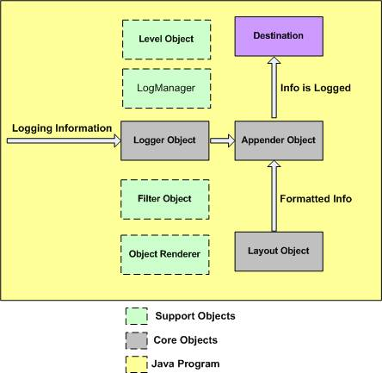
Virtual Component of Log4J

Slide 11
Support Objects
LEVEL OBJECT:
The Level object defines the granularity and priority of any logging information. There are seven levels of logging defined within the API: OFF, DEBUG, INFO, ERROR, WARN, FATAL, and ALL.
FILTER OBJECT:
The Filter object is used to analyze logging information and make further decisions on whether that information should be logged or not.
An Appender objects can have several Filter objects associated with them. If logging information is passed to a particular Appender object, all the Filter objects associated with that Appender need to approve the logging information before it can be published to the attached destination.
OBJECTRENDERER:
The ObjectRenderer object is specialized in providing a String representation of different objects passed to the logging framework. This object is used by Layout objects to prepare the final logging information.
LOGMANAGER:
The LogManager object manages the logging framework. It is responsible for reading the initial configuration parameters from a system-wide configuration file or a configuration class.

Slide 12
Default Log4J Logging
import org.apache.log4j.Logger;
import org.apache.log4j.BasicConfigurator;
public class HelloWorld2 {
static Logger logger = Logger.getLogger("chapter1.HelloWorld2");
static public void main(String[] args) {
BasicConfigurator.configure();
logger.debug("Hello world.");
}
}

Slide 13
Default Logging Processes (Basic)
Configure log4j for your environment. Log4j offers many sophisticated means of configuration, BasicConfigurator.configure() being the simplest but also the least flexible.
NOTE: Log4j normally needs to be configured only once

Slide 14
Default…
In every class where you wish to perform logging, retrieve a Logger object by invoking the Logger.getLogger method and passing it a String, commonly the fully qualified name of the containing class. This logger object is usually declared as static final
Logger.getLogger("com.wombat.X"); // String variant
Logger.getLogger(X.class.getName());
// another String variant
Logger.getLogger(X.class.toString()); // convenient Class variant

Slide 15
Default…
Use this logger instance by invoking its printing methods, namely the debug(), info(), warn(), error() and fatal() methods or the more generic log() method. This will produce logging output on selected devices

Slide 16
Levels
Every event that is logged has an assigned priority levels.
Fatal errors would be naturally be more severe than a simple warning and thus would have a higher level.
Each level has an integer value assigned to it so that it can be compared to other levels

Slide 17
Hierarchy of Levels
Lowest to highest:
DEBUG
INFO
WARN
ERROR
FATAL
Two special levels:
ALL
OFF

Slide 18
Main Logger (Root Logger)
By default we have RootLogger
RootLogger is the default logger (see Default Logger)
Logger can be package-level only
Loggers are named entities. Logger names are case-sensitive and follow the Named Hierarchy Rule:
A logger is said to be an ancestor of another logger if its name followed by a dot is a prefix of the descendant logger name.
A logger which is an immediate ancestor of a descendant is said to be a parent logger and the immediate descendant is said to be a child logger.

Slide 19
Appenders
In log4j speak, an output destination is called an appender.
Currently, appenders exist for the following:
console, files, Swing components, remote socket servers, JMS, NT Event Loggers, and remote UNIX Syslog daemons
It is also possible to log asynchronously
Responsible for appending a log message to a specific target
Each appender has its own layout
It has its threshold which determines the level of priority that it will log

Slide 20
Characteristics of Appenders
Log4j allows attaching multiple appenders to any logger.
Appenders can be added to and removed from a logger at any time.
The central architectural concept in log4j is the hierarchical arrangement of loggers
A logger can make use of one and only one level. Appenders are different because multiple appenders can be attached to a logger.

Slide 21
Common Appenders
ConsoleAppender | Logs to console
FileAppender | Logs to a file
SMTPAppender | Logs by email
RollingFileAppender | Logs to a file, starts a new file once the max size is reached. (An alternative is theDailyRollingFileAppender which creates on file per day)

Slide 22
LoggingEvents
Logging events represent the actual event that gets logged and an instance created whenever the Log4J suite makes an affirmative decision to log something.
Information given by Logging Events:
Time event was created
The message itself
Any exception
Associated priority levels

Slide 23
LoggingEvent…
import org.apache.log4j.DailyRollingFileAppender;
import org.apache.log4j.spi.LoggingEvent;
public class MyDailyRollingFileAppender extends DailyRollingFileAppender {
@Override
protected void subAppend(LoggingEvent event) {
String modifiedMessage = String.format("**** Message modified by MyDailyRollingFileAppender ****\n\n%s\n\n**** Finished modified message ****", event.getMessage());
LoggingEvent modifiedEvent = new LoggingEvent(event.getFQNOfLoggerClass(), event.getLogger(), event.getTimeStamp(), event.getLevel(), modifiedMessage,
event.getThreadName(), event.getThrowableInformation(), event.getNDC(), event.getLocationInformation(),
event.getProperties());
super.subAppend(modifiedEvent);
}
}

Slide 24
LoggingEvents…
Need to be overriden when creating your own appender
Not used by developers; no need to be codes
Passed around Log4J Components
Output of logging events is used to format and print information to the desired target

Slide 25
Layout
The layout is responsible for formatting the logging request according to the user‘s wishes, whereas an appender takes care of sending formatted output to its destination.
Most layouts are not designed to be shared by multiple appenders.
It follows that each appender has its own “private” layout.

Slide 26
Types of Layout
HTMLLayout
HTMLLayout prints out log events in an HTML table. It returns appropriate header and footers to complete the HTML document.
<tr>
<td>0</td>
<td title="main thread">main</td>
<td title="Level"><font color="#339933">DEBUG</font></td>
<td title="root category">root</td>
<td title="Message">Debug Message</td>
</tr>

Slide 27
Types of Layout
PatternLayout
PatternLayout formats a logging event according to a conversion pattern that is similar to the conversion pattern of the sprintf function in C.
The conversion pattern consists of literal text and conversion specifiers.
12/20/2005 4:53:33 PM [DEBUG] Debug message

Slide 28
Types of Layout
SimpleLayout
SimpleLayout provides basic formatting, the output from this layout is the priority level of the log message followed by a dash (-) and the log message itself. It returns the default implementation for all other methods defined in the Layout class, thus empty header and footer strings and it ignores exceptions
DEBUG - Button Clicked

Slide 29
Types of Layout…
TTCLayout
TTCCLayout consists of the time, thread, priority level and diagnostic context information.
262 [main] DEBUG org.apache.log4j.examples.SortAlgo.OUTER i=1 - Outer loop.

Slide 30
Types of Layout…
XMLLayout
The output of the XMLLayout consists of a series of log4j:event elements as defined in the log4j.dtd. It does not output a complete well-formed XML file. The output is designed to be included as an external entity in a separate file to form a correct XML file.
<log4j:event logger="root"
timestamp="1135964385140"
level="DEBUG"
thread="main">
<log4j:message>
<![CDATA[Debug Message]]>
</log4j:message>
</log4j:event>

Slide 31
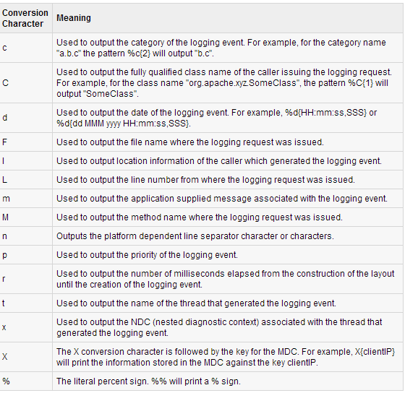
Conversion Pattern

Slide 32
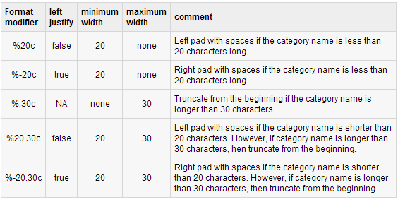
Conversion Pattern…
Formatters

Slide 33
Log4j Configuration File
It is a property file
Sample:
# Set root logger level to DEBUG and add an appender called A1.
log4j.rootLogger=DEBUG, A1
# A1 is set to be a ConsoleAppender.
log4j.appender.A1=org.apache.log4j.ConsoleAppender
# A1 uses PatternLayout.
log4j.appender.A1.layout=org.apache.log4j.PatternLayout
log4j.appender.A1.layout.ConversionPattern=%-4r [%t] %-5p %c %x -%m%n

Slide 34
JEE Logging (Servlet)
Create your log4j.properties file
Method 1: Use Servlet to initialize log4j
Put log4j.properties file in the right place
Place 'log4j.properties' in the src. When web application is deployed it should be in /WEB-INF/classes/log4j.properties (ANT ☺)
Define the servlet mapping in web.xml
<servlet>
<servlet-name>log4j-init</servlet-name>
<servlet-class>corg.orion.training.codes.Log4jInit</servlet-class>
<init-param>
<param-name>log4j-init-file</param-name>
<param-value>WEB-INF/classes/log4j.properties</param-value>
</init-param>
<load-on-startup>1</load-on-startup>
</servlet>

Slide 35
JEE Logging (Servlet)
Create the servlet
import javax.servlet.http.HttpServlet;
import org.apache.log4j.PropertyConfigurator;
public class Log4jInit extends HttpServlet {
public void init()
{
String prefix = getServletContext().getRealPath("/");
String file = getInitParameter("log4j-init-file");
// if the log4j-init-file context parameter is not set, then no point in trying
if(file != null){
PropertyConfigurator.configure(prefix+file);
System.out.println("Log4J Logging started: " + prefix+file);
}
else{
System.out.println("Log4J Is not configured for your Application: " + prefix + file);
}
}
}

Slide 36
JEE Logging (Servlet)
Initialize the logger and start logging from other servlets in your web application
public class MyServlet extends HttpServlet {
...
private Logger log = Logger.getLogger("<appname>logger");
.
.
.
log.debug("Some string to print out");
}

Slide 37
JEE Logging (Listener)
Method 2: Initialize log4j in a ServletContextListener
Put properties file in the right place (Same in method 1)
Define a listener mapping in web.xml
<listener>
<listener-class>
com.package.listeners.ApplicationServletContextListener
</listener-class>
</listener>
Declare properties file path as context parameter

Slide 38
JEE Logging (Listener)
Create the SerlvetContextListener class
public class ApplicationServletContextListener implements ServletContextListener{
public void contextInitialized(ServletContextEvent event) {
ServletContext ctx = event.getServletContext();
String prefix = ctx.getRealPath("/");
// String file = Get context param
if(file != null) {
PropertyConfigurator.configure(prefix+file);
System.out.println("Log4J Logging started for application: " + prefix+file);
}
else
{
System.out.println("Log4J Is not configured for application Application: " + prefix+file);
}
}

Slide 39
JEE Logging (Listener)
Define the logger and start logging from other servlets in your applications (Same method 1)

Slide 40
Log4J Taglib
Download log4j Taglib JAR. Store them in /lib folder inside WEB-INF
Create log4j.properties file and save them in src to be deployed in classes (ANT ☺)
Add the following taglib:
<taglib> <taglib-uri>http://jakarta.apache.org/taglibs/log-1.0</taglib-uri> <taglib-location>/WEB-INF/taglibs-log.tld</taglib-location> </taglib>
Then use them in JSPs:
<%@ taglib uri="http://jakarta.apache.org/taglibs/log-1.0" prefix="log" %>

Slide 41
Log4J JSTL
JSTL version:
<%@ taglib uri=“http://jakarta.apache.org/taglibs/log-1.0” prefix=“log” %> <html> <head> <title>Demonstration log4j usage in jsp</title> </head> <body> <log:debug>Show DEBUG message</log:debug><br/> <log:info>Show INFO message“</log:info><br/> <log:warn>Show WARN message</log:warn><br/> <log:error>Show ERROR message</log:error><br/> <log:fatal>Show FATAL message</log:fatal> </body> </html>

Slide 42
Log4J Scriptlet
<%@ page import="org.apache.log4j.Logger" %> <html> <head> <title>Demonstration log4j usage in jsp</title> </head> <body> <% Logger log = Logger.getLogger("com.mobilefish.demo.test"); log.debug("Show DEBUG message"); log.info("Show INFO message"); log.warn("Show WARN message"); log.error("Show ERROR message"); log.fatal("Show FATAL message"); %> <b> The log messages are shown in the Tomcat console and in the ${catalina.home}/logs/demo.log file. </b> </body> </html>

Slide 43
Sample Properties File
# ***** Set root logger level to DEBUG and its two appenders to stdout and R. log4j.rootLogger=debug, stdout, R # ***** stdout is set to be a ConsoleAppender. log4j.appender.stdout=org.apache.log4j.ConsoleAppender # ***** stdout uses PatternLayout. log4j.appender.stdout.layout=org.apache.log4j.PatternLayout log4j.appender.stdout.layout.ConversionPattern=%d [%c] %p - %m%n # ***** R is set to be a RollingFileAppender. log4j.appender.R=org.apache.log4j.RollingFileAppender log4j.appender.R.File=${catalina.home}/logs/demo.log # ***** Max file size is set to 100KB log4j.appender.R.MaxFileSize=100KB # ***** Keep one backup file log4j.appender.R.MaxBackupIndex=1 # ***** R uses PatternLayout. log4j.appender.R.layout=org.apache.log4j.PatternLayout log4j.appender.R.layout.ConversionPattern=%d [%c] %p - %m%n

Slide 44
Other Logging Plugins
Commons Logging (Apache Commons)
ultra-thin bridge between different logging implementations
Simple Logging Façade for Java (sl4j)
serves as a simple facade or abstraction for various logging frameworks (e.g. java.util.logging, logback, log4j) allowing the end user to plug in the desired logging framework at deployment time.

